Slide 1
- Velocity and Acceleration - Force, Strain and Tactile Sensors
Presenters:
Timour Guerrier
Mubashara Rehman

Slide 2
Chapter 8 Velocity and Acceleration
Acceleration requires application of a force
2nd law of newton :
a=​​​ΣF​​ / m
Velocity is a first derivative of a position, acceleration is second
Position and displacement measurements : Low frequencies (0-10 Hz)
Velocity measurements: Intermediate frequencies (less than 1Khz)
Acceleration measurements: High frequencies

Slide 3
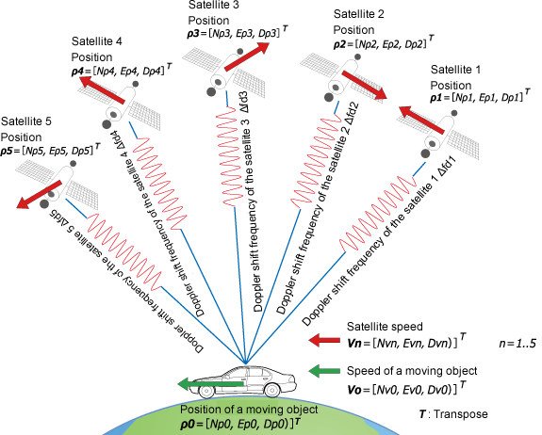
Velocity and acceleration
Speed of large object can be determined by GPS
but not for small object and short distance

Slide 4
Capacitive accelerometers
A capacitive acceleration sensor contains :
- A stationary plate (connected to the housing)
- A plate attached to the inertial mass
They form a capacitor whose value is function the distance between the plates. The capacitor value is modulated by the acceleration.
Their performance is superior in low frequencies range

Slide 5
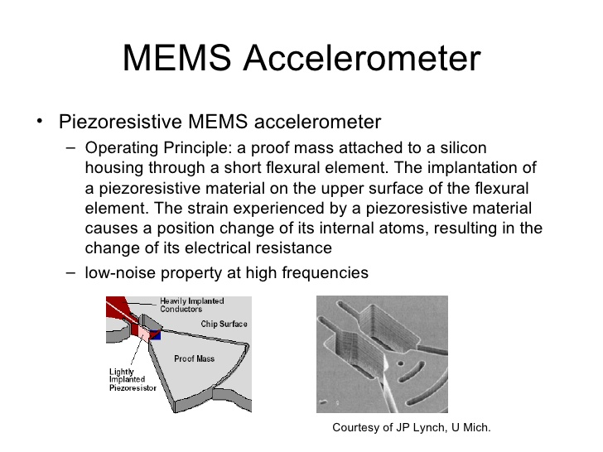
Piezoresistive accelerometers
As a sensing element, a piezoresistive accelerometer incorporates a strain gauge that measures strain in the mass-supporting springs. The strain can be directly correlated with the magnitude and rate of the mass displacement and, subsequently, with an acceleration.

Slide 6
Piezoelectric Accelerometers
These sensors operate from frequency as low as 2 Hz and up to about 5 kHz, they posses good off-axis noise rejection, high linearity, and a wide operating temperature range (up to 120C).
The piezoelectric effect has a natural application in sensing vibration and acceleration. The effect is a direct conversion of mechanical energy into electrical energy (Sect. 3.6) in a crystalline material composed of electrical dipoles.

Slide 7
Thermal accelerometer : heated plate accelerometer
A thermal accelerometer, as any other accelerometer, contains a seismic mass that is suspended by a thin cantilever and positioned in close proximity with a heat sink, or between two heat sinks . The mass and the cantilever structure are fabricated using a micro-machined technology. The space between these components is filled with a thermally conductive gas.

Slide 8
Thermal Accelerometer : Heated Gas Accelerometers
It is based on heat transfer by forced convection. The sensor measures the internal changes in heat transfer of the trapped gas

Slide 9
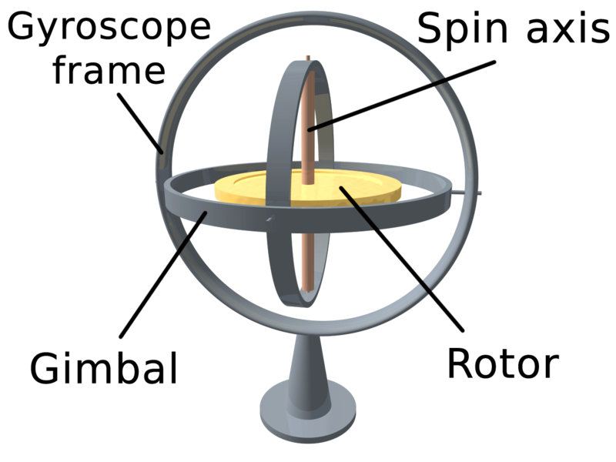
Gyroscopes
A gyroscope is a spinning wheel or disc in which the axis of rotation is free to assume any orientation by itself. When rotating, the orientation of this axis is unaffected by tilting or rotation of the mounting. Because of this, gyroscopes are useful for measuring or maintaining orientation

Slide 10
Rotor Gyroscope
When the wheel (rotor) freely rotates, it tends to preserve its axial position. If the gyro platform rotates around the input axis, the gyro will develop a torque around a perpendicular (output) axis, thus turning its spin axis around the output axis. This phenomenon is called precession of a gyro. It can be explained by Newton’s law of motion for rotation: the time rate of change of angular momentum about any given axis is equal to the torque applied about the given axis.
Qualities of a gyroscope :
- Spin axis of a free gyroscope will remain fixed with respect to space
- It can be made to deliver a torque proportional to the angular velocity about an axis perpendicular to the spin axis

Slide 11
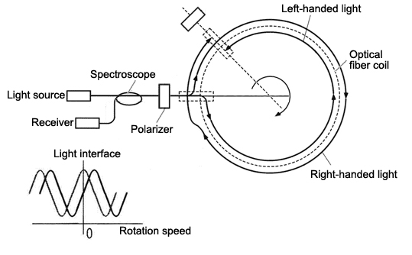
Optical gyroscope
These sensors are based on the Sagnac effect.

Slide 12
Piezoelectric Cables
It is used in a vibration sensor built with a mineral insulated cable. Cables generate an electric signal in it’s internal conductor when the outer surface of the cable is subjected to variable compressions.
It is used in detection of insects in silos, automobile traffic analysis …

Slide 13
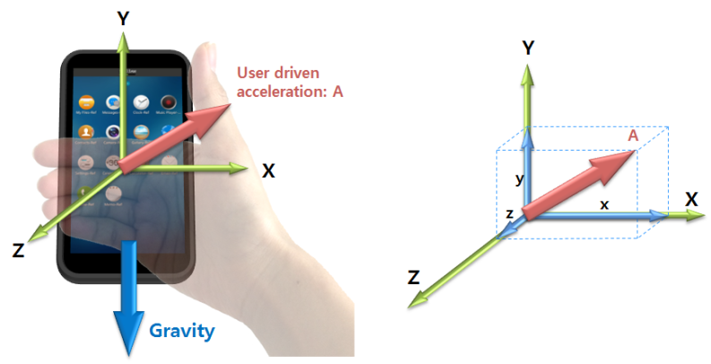
Gravitational sensors
It has it’s own internal axis for the different direction. It measure an angle beteween it’s own internal axis and the gravity vector.
Some gravity sensors :
Mercury switch
Electrolytic tilt sensor ( for angular displacement)

Slide 14
Chapter 9 Force, Strain and Tactile Sensors

Slide 15
Basic Concept
Newton stated his first law as:
“Every body persists in its state of rest or of uniform motion in a straight line unless it is compelled to change that state by forces impressed on it.”
Sometimes, this is called a law of inertia. Another way to state the first law is to say that:
“If no net force acts on a body, its acceleration a is zero.”

Slide 16
Types of Force Sensors
Force sensors can be divided into two classes:
Quantitative and Qualitative
A quantitative sensor actually measures the force and represents its value in terms of an electrical signal.
Examples of these sensors are strain gauges and load cells.
The qualitative sensors are the threshold devices that are not concerned with a good fidelity of representation of the force value. Their function is merely to indicate whether a sufficiently strong force is applied or not.

Slide 17
Strain Gauges
“Strain is deformation of a physical body under the action of applied forces.”
Strain gauge is a resistive elastic sensor whose resistance is function of the applied strain (unit deformation).

Slide 18
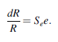
That relationship is generally called the Piezoresistive Effect,
Piezoresistive Effect is expressed through the gauge factor Se of the conductor
For many materials Se=2 with the exception of platinum for which Se=6

Slide 19
Tactile Sensors
The tactile sensors loosely can be subdivided into three subgroups:
Touch Sensors. These sensors detect and measure contact forces at defined points.
Spatial Sensors. These sensors detect and measure the spatial distribution of forces perpendicular to a predetermined sensory area, and the subsequent interpretation of the spatial information.
Slip Sensors. These sensors detect and measure the movement of an object relative to the sensor. This can be achieved either by a specially designed slip sensor or by the interpretation of the data from a touch sensor or a spatial array.

Slide 20
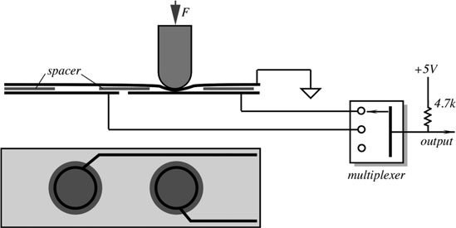
Switch Sensors:
A simple tactile sensor producing an “on–off” output can be formed with two leaves of foil and a spacer
One leaf is grounded and the other is connected to a pull-up resistor.
When an external force is applied to the upper conductor over the hole in the spacer, the top leaf flexes and upon reaching the lower conductor, makes an electric contact, grounding the pull-up resistor.
The output signal becomes zero indicating the applied force.
Multiple sensing spots can be formed by printing rows and columns of a conductive ink.

Slide 21
Piezoelectric Sensors
The Piezoelectric effect is an effect in which energy is converted between mechanical and electrical forms.
Specifically, when a pressure is applied to a polarized crystal, the resulting mechanical deformation results in an electrical charge.

Slide 22
Piezoresistive Sensors
The piezoresistive effect also involves pressure or stress. However, changes in resistance across the piezo material are the product, not a charge or voltage. It is a change in electrical resistance of a semiconductor material due to mechanical stress.
Made from semiconductor materials, piezoresistive devices most commonly are used in pressure measurement.
When pressure is applied to a piezo resistor, depending on the material, its resistance increases.

Slide 23
MEMS Sensors
Micro-electro-mechanical systems
Miniaturized mechanical and electro-mechanical elements
Having some sort of mechanical functionality
Convert a measured mechanical signal into an electrical signal.

Slide 24
Capacitive Touch Sensors
A capacitive touch sensor is based on fundamental equations for the parallel-plate and coaxial capacitors.
A capacitive touch sensor relies on the applied force that either changes the distance between the plates or the variable surface area of the capacitor.
In such a sensor, two conductive plates are separated by a dielectric medium, which is also used as the elastomer to give the sensor its force to capacitance characteristics

Slide 25
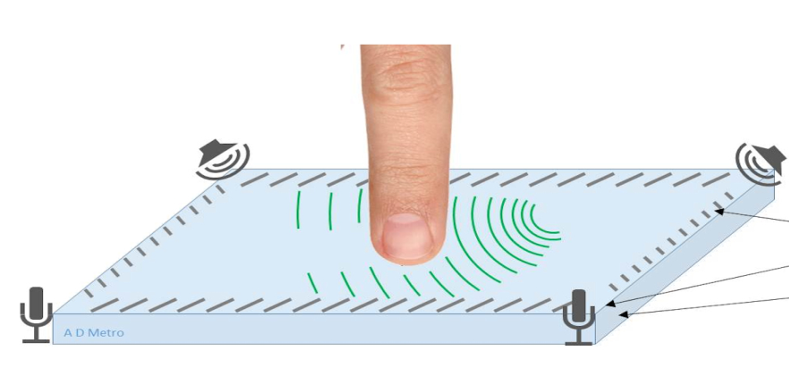
Acoustic Touch Sensors
Acoustic touch screen is based on the recognition of sound waves propagating in an object when the user touches it.
A touch of an object produces a pattern of sound waves propagating through the material.
This pattern creates an acoustic signature that is unique to the location of the impact.

Slide 26
Optical Sensors
An optical sensor is generally part of a larger system that integrates a source of light, a measuring device and the optical sensor. This is often connected to an electrical trigger. The trigger reacts to a change in the signal within the light sensor.

Slide 27
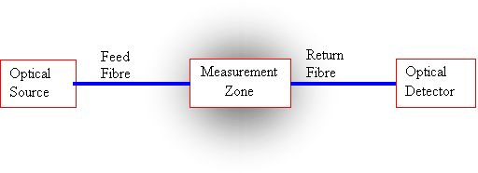
Work Principle
Light beam changes by the phenomena that is being measured
Light may change in its five optical properties i.e intensity, phase, polarization,wavelength and spectral distribution.

Slide 28
References
Jacob Fraden, Handbook of Modern Sensors Physics, Designs, and Applications
https://en.wikipedia.org/wiki/Electro-optical_sensor
https://en.wikipedia.org/wiki/Capacitive_sensing
http://ieeexplore.ieee.org/Xplore/login.jsp?url=http%3A%2F%2Fieeexplore.ieee.org%2Fstamp%2Fstamp.jsp%3Farnumber%3Dx0053573&authDecision=-203

Slide 29
Thank You ☺

